Slide 1
Chapter 7:
Computer and
Network Security

Slide 2
Chapter Overview
Introduction
Hacking
Malware
Cyber crime and cyber attacks
Online voting
1-<number>

Slide 3
7.1 Introduction
Computers getting faster and less expensive
Utility of networked computers increasing
  Shopping and banking
  Managing personal information
  Controlling industrial processes
Increasing use of computers → growing importance of computer security
1-<number>

Slide 4
7.2 Hacking
1-<number>

Slide 5
Hackers, Past and Present
Original meaning of hacker: explorer, risk taker, system innovator
  MIT’s Tech Model Railroad Club in 1950s
1960s-1980s: Focus shifted from electronics to computers and networks
  1983 movie WarGames
Modern meaning of hacker: someone who gains unauthorized access to computers and computer networks
1-<number>

Slide 6
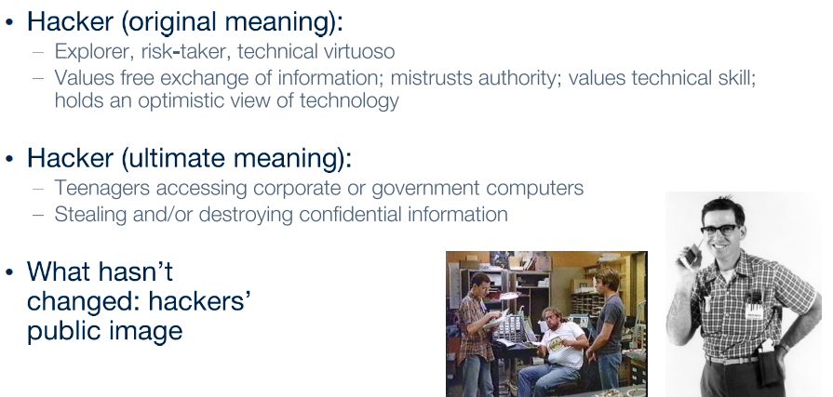
Hackers
1-<number>

Slide 7
Obtaining Login Names, Passwords
Eavesdropping
Dumpster diving
Social engineering
1-<number>

Slide 8
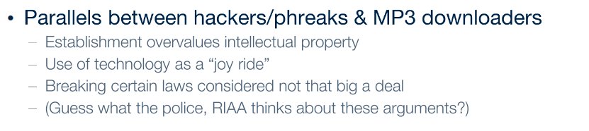
Ethics of Hacking
1-<number>

Slide 9
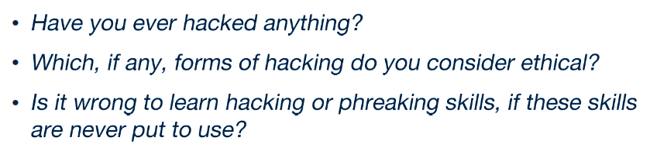
1-<number>

Slide 10
Password Dos and Don’ts
Do not use short passwords.
Do not use a word from the dictionary.
Do not rely on substituting numbers for letters.
Do not reuse passwords.
Give ridiculous answers to security questions.
Enable two-factor authentication if available.
Have password recoveries sent to a secure email address.
1-<number>

Slide 11
Computer Fraud and Abuse Act
Criminalizes wide variety of hacker-related activities
  Transmitting code that damages a computer
  Accessing any Internet-connected computer without authorization
  Transmitting classified government information
  Trafficking in computer passwords
  Computer fraud
  Computer extortion
Maximum penalty: 20 years in prison and $250,000 fine
1-<number>

Slide 12
Sidejacking
Sidejacking: hijacking of an open Web session by capturing a user’s cookie
Sidejacking possible on unencrypted wireless networks because many sites send cookies “in the clear”
Internet security community complained about sidejacking vulnerability for years, but ecommerce sites did not change practices
1-<number>

Slide 13
Case Study: Firesheep
October 2010: Eric Butler released Firesheep extension to Firefox browser
Firesheep made it possible for ordinary computer users to easily sidejack Web sessions
More than 500,000 downloads in first week
Attracted great deal of media attention
Early 2011: Facebook and Twitter announced options to use their sites securely
1-<number>

Slide 14
Act Utilitarian Analysis
Release of Firesheep led media to focus on security problem
Benefits were high: a few months later Facebook and Twitter made their sites more secure
Harms were minimal: no evidence that release of Firesheep caused big increase in identity theft or malicious pranks
Conclusion: Release of Firesheep was good
1-<number>

Slide 15
Virtue Ethics Analysis
By releasing Firesheep, Butler helped public understand lack of security on unencrypted wireless networks
Butler’s statements characteristic of someone interested in protecting privacy
Butler demonstrated courage by taking responsibility for the program
Butler demonstrated benevolence by making program freely available
His actions and statements were characteristic of someone interested in the public good
1-<number>

Slide 16
Kantian Analysis
Accessing someone else’s user account is an invasion of their privacy and is wrong
Butler provided a tool that made it much simpler for people to do something that is wrong, so he has some moral accountability for their misdeeds
Butler was willing to tolerate short-term increase in privacy violations in hope that media pressure would force Web retailers to add security
He treated victims of Firesheep as a means to his end
It was wrong for Butler to release Firesheep
1-<number>

Slide 17
7.3 Malware : Evil code that can run on your device
1-<number>

Slide 18
Viruses
Virus: Piece of self-replicating code embedded within another program (host)
Viruses associated with program files
  Hard disks, floppy disks, CD-ROMS, USBs
  Email attachments
How viruses spread
  Diskettes/ CDs / USBs
  Email or Files downloaded from Internet
Have you ever (knowingly) gotten one ?
1-<number>

Slide 19
Antivirus Software Packages
Allow computer users to detect and destroy viruses
Must be kept up-to-date to be most effective
Many people do not keep their antivirus software packages up-to-date
Consumers need to beware of fake antivirus applications
1-<number>

Slide 20
Worm
Self-contained program
Spreads through a computer network
Exploits security holes in networked computers
A worm can self-replicate and spread to other computers, while a virus cannot. A virus needs to be sent from one computer to another by a user or via software.
1-<number>

Slide 21
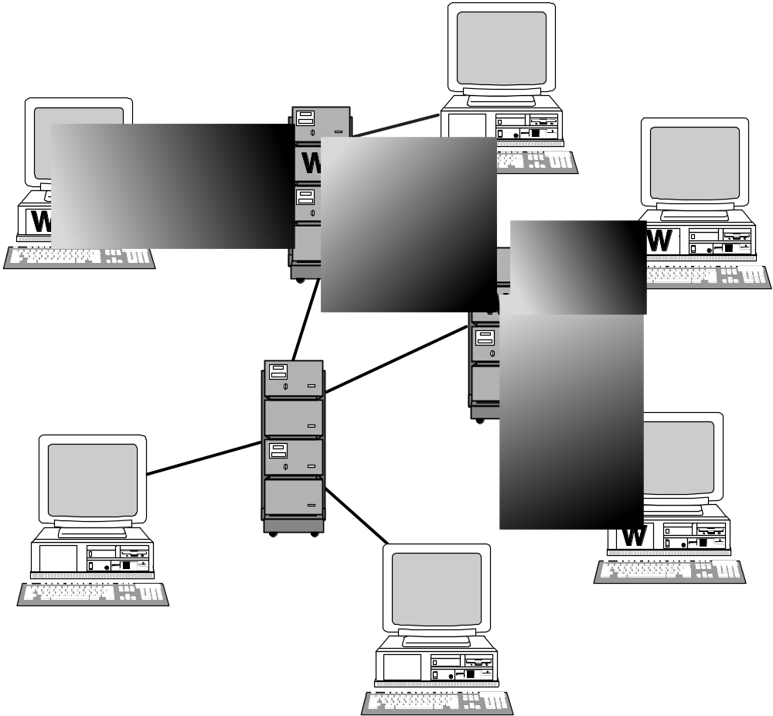
How a Worm Spreads
1-<number>

Slide 22
The Internet Worm
Robert Tappan Morris, Jr.
  Graduate student at Cornell
  Released worm onto Internet from MIT computer
Effect of worm
  Spread to significant numbers of Unix computers
  Infected computers kept crashing or became unresponsive
  Took a day for fixes to be published
Impact on Morris
  Suspended from Cornell
  3 years’ probation + 400 hours community service
  $150,000 in legal fees and fines
1-<number>

Slide 23
Ethical Evaluation
Kantian evaluation
  Morris used others by gaining access to their computers without permission
Social contract theory evaluation
  Morris violated property rights of organizations
Utilitarian evaluation
  Benefits: Organizations learned of security flaws
  Harms: Time spent by those fighting worm, unavailable computers, disrupted network traffic, Morris’s punishments
Virtue ethics evaluation
  Morris selfishly used Internet as experimental lab
  He deceitfully released worm from MIT instead of Cornell
  He avoided taking responsibility for his actions
Morris was wrong to have released the Internet worm
1-<number>

Slide 24
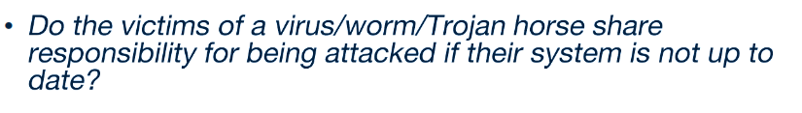
Trojan Horses and Backdoor Trojans
Trojan horse: Program with benign capability that masks a sinister purpose. Trojan horse stores critical data about a computer system or a network.
Backdoor Trojan: Trojan horse that gives attack access to victim’s computer
1-<number>

Slide 25
Cross-site Scripting
Another way malware may be downloaded without user’s knowledge
Problem appears on Web sites that allow people to read what others have posted
Attacker injects client-side script into a Web site
Victim’s browser executes script, which may steal cookies, track user’s activity, or perform another malicious action
1-<number>

Slide 26
Drive-by Downloads
Unintentional downloading of malware caused by visiting a compromised Web site
Also happens when Web surfer sees pop-up window asking permission to download software and clicks “Okay”
Google Anti-Malware Team says 1.3 percent of queries to Google’s search engine return a malicious URL somewhere on results page
1-<number>

Slide 27
Rootkits
Rootkit: A set of programs that provides privileged access to a computer
Activated every time computer is booted
Uses security privileges to mask its presence
1-<number>

Slide 28
Spyware and Adware
Spyware: Program that communicates over an Internet connection without user’s knowledge or consent
  Monitor Web surfing
  Log keystrokes
  Take snapshots of computer screen
  Send reports back to host computer
Adware: Type of spyware that displays pop-up advertisements related to user’s activity
Backdoor Trojans often used to deliver spyware and adware
1-<number>

Slide 29
Bots
Bot: A kind of backdoor Trojan that responds to commands sent by a command-and-control program on another computer
First bots supported legitimate activities
  Internet Relay Chat
  Multiplayer Internet games
Other bots support illegal activities
  Distributing spam
  Collecting person information for ID theft
  Denial-of-service attacks
1-<number>

Slide 30
Botnets and Bot Herders
Botnet: Collection of bot-infected computers controlled by the same command-and-control program
Some botnets have over a million computers in them
Bot herder: Someone who controls a botnet
1-<number>

Slide 31
Defensive Measures
Security patches: Code updates to remove security vulnerabilities
Anti-malware tools: Software to scan hard drives, detect files that contain viruses or spyware, and delete these files
Firewall: A software application installed on a single computer that can selectively block network traffic to and from that computer
1-<number>

Slide 32
What steps do you take to protect the security of your digital devices?
1-<number>

Slide 33
7.4 Cyber Crime and Cyber Attacks
1-<number>

Slide 34
Phishing and Spear-phishing
Phishing: Large-scale effort to gain sensitive information from gullible computer users
  Estimated 3.4 billion emails a day are sent by cyber criminals (over a trillion phishing emails per year)
  Email impersonation accounts for an estimated 1.2% of all email traffic globally.
Spear-phishing: Variant of phishing in which email addresses chosen selectively to target particular group of recipients
1-<number>

Slide 35
SQL Injection
Method of attacking a database-driven Web application with improper security
Attack inserts (injects) SQL query into text string from client to application
Application returns sensitive information
1-<number>

Slide 36
Denial-of-service and Distributed Denial-of-service Attacks
Denial-of-service attack: Intentional action designed to prevent legitimate users from making use of a computer service
Aim of a DoS attack is not to steal information but to disrupt a server’s ability to respond to its clients
Distributed denial-of-service attack: DoS attack launched from many computers, such as a botnet
1-<number>

Slide 37
Cyber Crime
Criminal organizations making significant amounts of money from malware
Jeanson James Ancheta
Pharmamaster
Albert Gonzalez
Avalanche Gang
1-<number>

Slide 38
The Rise and Fall of Blue Security Part I: The Rise
Blue Security: An Israeli company selling a spam deterrence system
Blue Frog bot would automatically respond to each spam message with an opt-out message
Spammers started receiving hundreds of thousands of opt-out messages, disrupting their operations
6 of 10 of world’s top spammers agreed to stop sending spam to users of Blue Frog
1-<number>

Slide 39
The Rise and Fall of Blue Security Part II: The Fall
One spammer (PharmaMaster) started sending Blue Frog users 10-20 times more spam
PharmaMaster then launched DDoS attacks on Blue Security and its business customers
Blue Security could not protect its customers from DDoS attacks and virus-laced emails
Blue Security reluctantly terminated its anti-spam activities
1-<number>

Slide 40
Politically Motivated Cyber Attacks
Estonia (2007)
Georgia (2008)
Georgia (2009)
Exiled Tibetan Government (2009)
United States and South Korea (2009)
Iran (2009)
Espionage attributed to People’s Liberation Army
Anonymous
1-<number>

Slide 41
Attacks on Twitter and Other Social Networking Sites
Massive DDoS attack made Twitter service unavailable for several hours on August 6, 2009
Three other sites attacked at same time: Facebook, LiveJournal, and Google
All sites used by a political blogger from the Republic of Georgia
Attacks occurred on first anniversary of war between Georgia and Russia over South Ossetia
1-<number>

Slide 42
Fourth of July Attacks
4th of July weekend in 2009: DDoS attack on governmental agencies and commercial Web sites in United States and South Korea
Attack may have been launched by North Korea in retaliation for United Nations sanctions
1-<number>

Slide 43
Supervisory Control and Data Acquisition (SCADA) Systems
Industrial processes require constant monitoring
Computers allow automation and centralization of monitoring
Today, SCADA systems are open systems based on Internet Protocol
  Less expensive than proprietary systems
  Easier to maintain than proprietary systems
  Allow remote diagnostics
Allowing remote diagnostics creates security risk
1-<number>

Slide 44
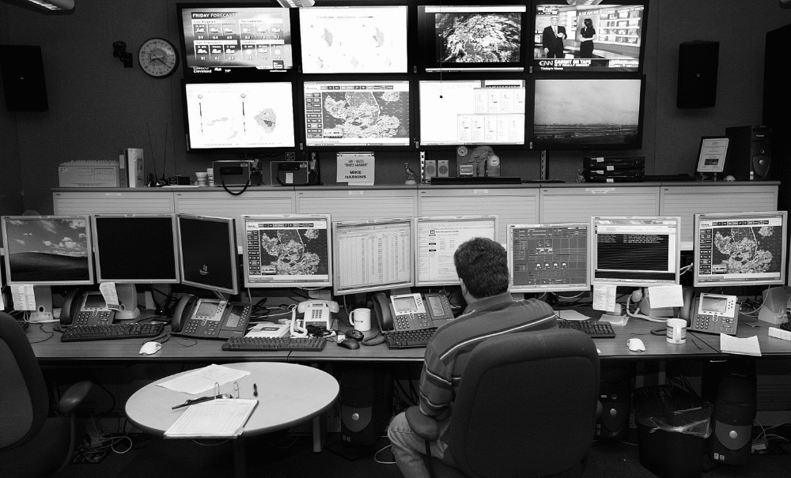
SCADA Systems Carry Security Risks
© p77/ZUMA Press/Newscom
1-<number>

Slide 45
Stuxnet Worm (2009)
Attacked SCADA systems running Siemens software
Targeted five industrial facilities in Iran that were using centrifuges to enrich uranium
Caused temporary shutdown of Iran’s nuclear program
Worm may have been created by Israeli Defense Forces
1-<number>

Slide 46
Cyber Espionage Attributed to People’s Liberation Army
Hundreds of computer security breaches in more than a dozen countries investigated by Mandiant
Hundreds of terabytes of data stolen
Mandiant blamed Unit 61398 of the People’s Liberation Army
China’s foreign ministry stated that accusation was groundless and irresponsible
1-<number>

Slide 47
Anonymous
Anonymous: loosely organized international movement of hacktivists (hackers with a social or political cause)
Various DDoS attacks attributed to Anonymous members
Year | Victim | Reason
2008 | Church of Scientology | Attempted suppression of Tom Cruise interview
2009 | RIAA, MPAA | RIAA, MPAA’s attempt to take down the Pirate Bay
2009 | PayPal, VISA, MasterCard | Financial organizations freezing funds flowing to Julian Assange of WikiLeaks
2012 | U.S. Dept. of Justice, RIAA, MPAA | U.S. Dept. of Justice action against Megaupload
1-<number>

Slide 48
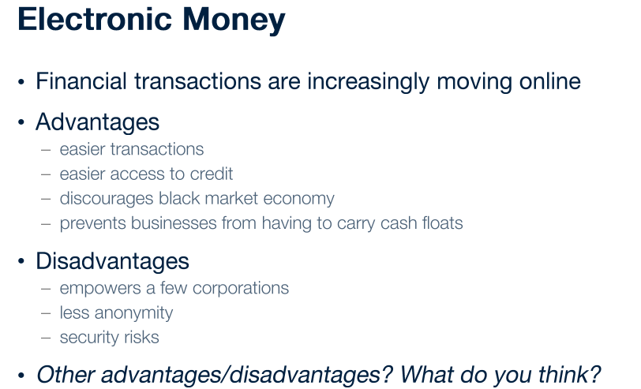
1-<number>

Slide 49
7.5 Online Voting
1-<number>

Slide 50
Motivation for Online Voting
2000 U.S. Presidential election closely contested
Florida pivotal state
Most Florida counties used keypunch voting machines
Two voting irregularities traced to these machines
  Hanging chad
  “Butterfly ballot” in Palm Beach County
1-<number>

Slide 51
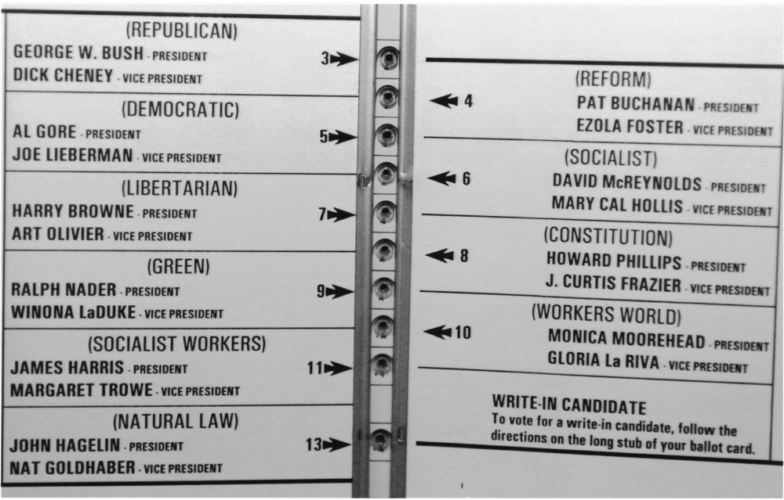
The Infamous “Butterfly Ballot”
1-<number>
AP Photo/Gary I. Rothstein

Slide 52
Benefits of Online Voting
More people would vote
Votes would be counted more quickly
No ambiguity with electronic votes
Cost less money
Eliminate ballot box tampering
Software can prevent accidental over-voting
Software can prevent under-voting
1-<number>

Slide 53
Risks of Online Voting
Gives unfair advantage to those with home computers
More difficult to preserve voter privacy
More opportunities for vote selling
Obvious target for a DDoS attack
Security of election depends on security of home computers
Susceptible to vote-changing virus or RAT
Susceptible to phony vote servers
No paper copies of ballots for auditing or recounts
1-<number>

Slide 54
Utilitarian Analysis
Suppose online voting replaced traditional voting
Benefit: Time savings
  Assume 50% of adults actually vote
  Suppose voter saves 1 hour by voting online
  Average pay in U.S. is $21.00 / hour
  Time savings worth $10.50 per adult American
Harm of DDoS attack difficult to determine
  What is probability of a DDoS attack?
  What is the probability an attack would succeed?
  What is the probability a successful attack would change the outcome of the election?
1-<number>

Slide 55
Kantian Analysis
The will of each voter should be reflected in that voter’s ballot
The integrity of each ballot is paramount
Ability to do a recount necessary to guarantee integrity of each ballot
There should be a paper record of every vote
Eliminating paper records to save time and/or money is wrong
1-<number>

Slide 56
Conclusions
Existing systems are highly localized
Widespread tainting more possible with online system
No paper records with online system
Evidence of tampering with online elections
Relying on security of home computers means system vulnerable to fraud
Strong case for not allowing online voting
1-<number>

